Slide 1
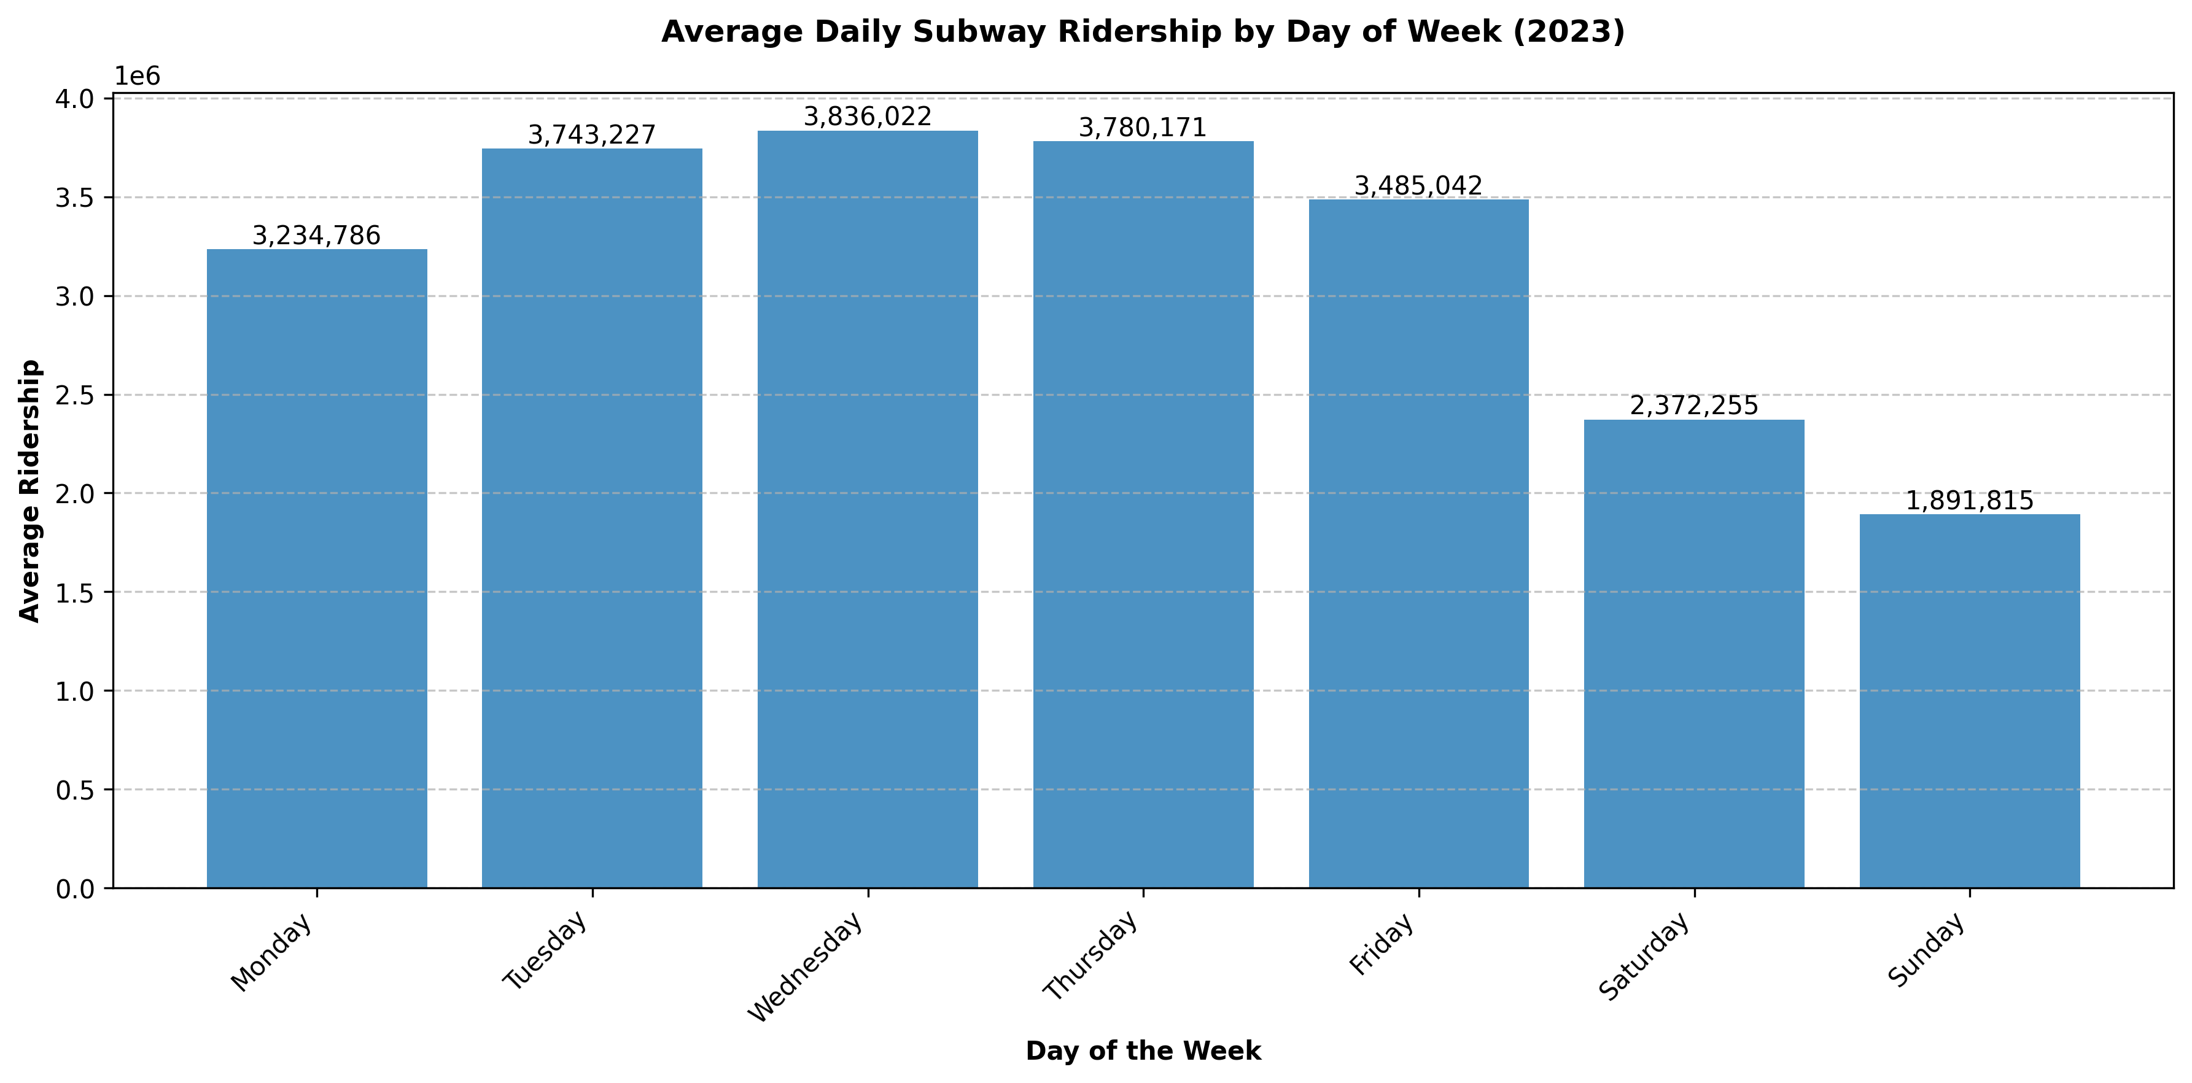
Average Daily Subway Ridership by Day of Week (2023)

Slide 2
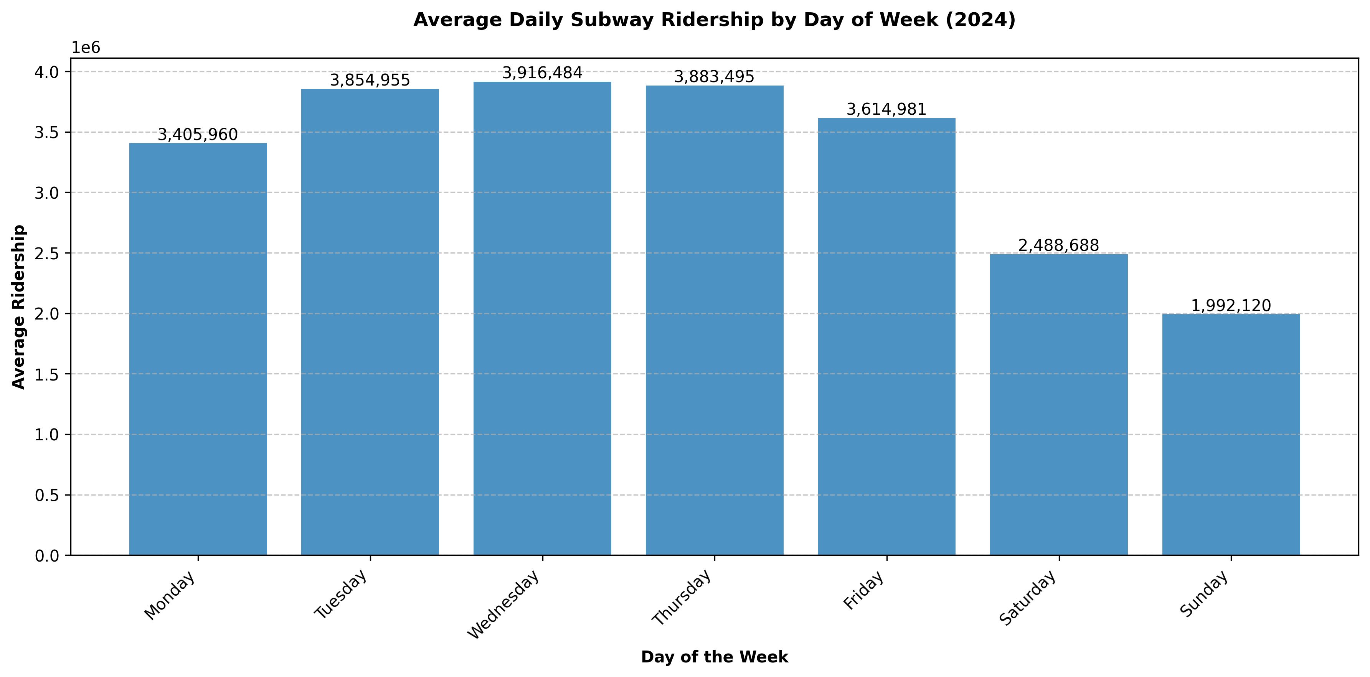
Average Daily Subway Ridership by Day of Week (2024)

